Slide 1
Virtual education space
s. Stoyanov, v. valkanova

Slide 2
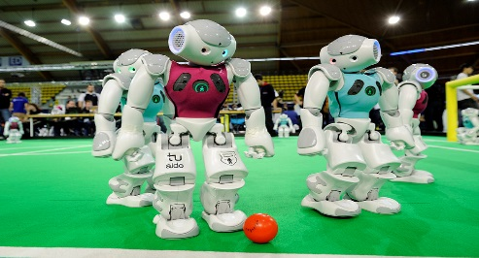
What happened?
2 PhD Thesis
V. Valkanov: “Context-Aware Management of eServices”
V. Valkanova: “Virtual Education Space for the Secondary School”
EU Project
Lecture Course “Cognitive Robotics”
Conference “From DeLC to VES” (26-28 March, Plovdiv)
Notes:
Two theses have been defended.
We are participating in an EU project aimed at improving the quality of education in computer science to more practice-oriented education.
Two important outcomes:
Updating and refining the curricula to more practice-oriented education
Introducing of practices in software companies
Dieter lectured the “Cognitive robotics” course.

Slide 3
curricula
BSc Curricula
Informatics
Business Information Technologies
Software Technologies and Design
MSc Curricula
Software Technologies
Business Informatics
Teaching of Informatics and Information Technologies
…
Notes:
The members of our group are directly involved in two curricula.

Slide 4
Lecture courses
Internet Programming (JEE)
SOA
AST
MSc
DB Integration
Project1
Project2
Thesis
Design Patterns (Java)
SW
IA
Cognitive Robotics
Design Patterns (Java)
Coursework2
AI
BSc
OOP (Java)
Data Basis
Coursework1
Programming in Java
Software Technologies
Notes:
Teaching content our group is responsible …
One of our tasks is to be able to show dependencies of these disciplines in the real software development.

Slide 5
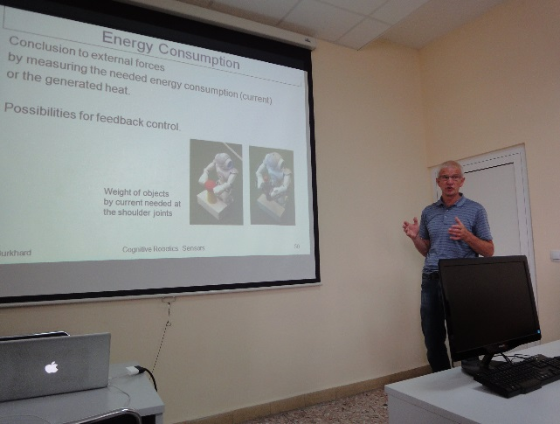
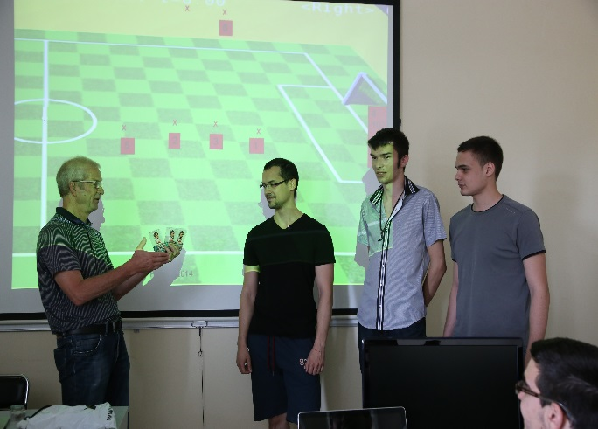
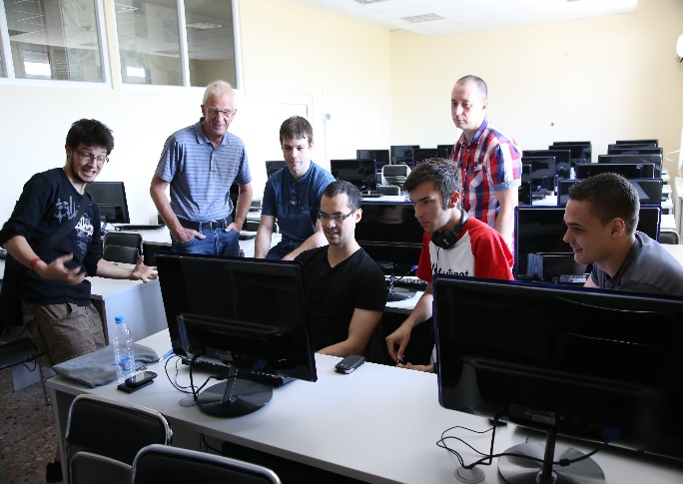
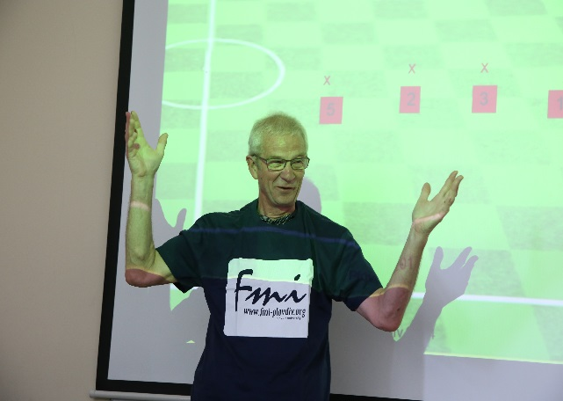
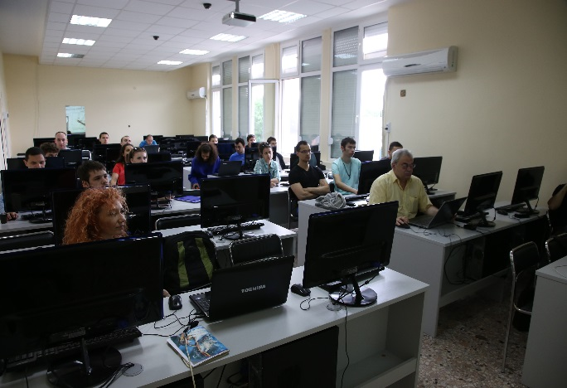
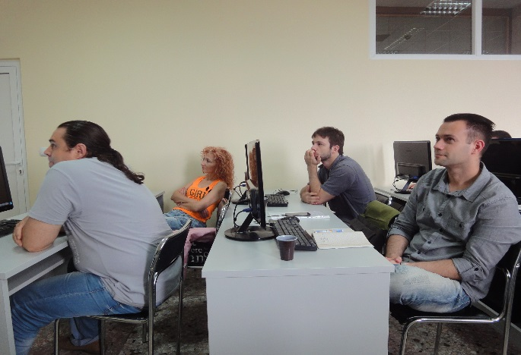
Robonewbie-plovdiv2014
Notes:
We attach great importance to this lecture course.
In our opinion, a very good motivation for the students is if we can demonstrate relationships under the various disciplines.
In this sense, the cognitive robotics course is a nice opportunity.

Slide 6
Summary
Teaching material
A relative big number of lecture course
MSc curriculum close related to the Informatics BSc curriculum in the faculty
A large number of students
Increasingly strong tendency – outside bachelors (e.g. more than 50 in the last year)
A relative small staff
Motivation of students
Good prepared and taught content not enough
Appropriate case studies demonstrating the relationships under the disciplines
E.g. “Cognitive robotics”
Integration of eLearning tools in the real education process
Notes:
Магистърската програма по СТ е съдържателно свързана с бакалавърската програма по информатика.
Все по-силна става тенденцията за участие в магистърската програма на бакалаври от други университети (напр. тази година около 50 студенти).
Цел: изграждане на единен модел за смесено обучение.
Long been striving to create an effective model for training where we have to comply with the following situation:
A relative varied content of the curricula
A large number of students
A relative small staff
Аs a possible solution we are trying to develop a model for blended learning.
The first step is the DeLC environment.

Slide 7
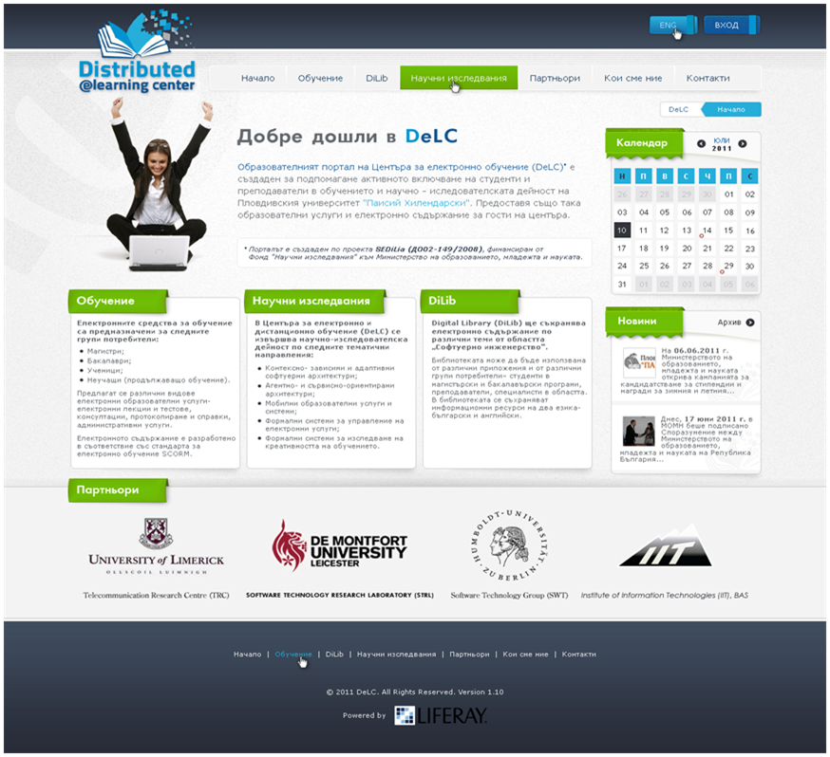
Delc
Notes:
The DeLC portal is in use for more than three years.
At the same time DeLC is a research project.
В този смисъл ние се стремим да развиваме концепцията на средата, съблюдавайки двете тенденции – Internet of things and Semantic web.
Следващата цел: по-тясна интеграция на физическия свят на реалния учебен процес с виртуалния свят на DeLC.
Идеята е DeLC да се развие в нова архитектура, която наричаме VES.

Slide 8
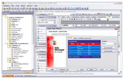
virtual education space
Personal assistants
Gards
Operatives
Notes:
Some features of the space:
VES is controlled infrastructure where access to information resources is only possible through the so-called "entry points."
The personal assistants operate as typical entry points while the education portal of DeLC is a specialized entry point.
A user has to be in possession of a personal assistant or to use the portal to be able to work in the space.
The VES consists of various types of software components for planning, preparation, organization and delivery of shareable, context-dependent and personalized e-learning services and e-learning content .
The architecture of the space includes various active components as shown in the figure.

Slide 9
General
Controlled infrastructure
Entry points
Business-functionality
Provided by services
Manаgement and control
Accomplished by agents
Only active components in the space

Slide 10
Personal Assistants
Personal assistants have to perform two main functions providing the needed "entry points" of the space
First, they operate as an interface between their owners and the space and if necessary, carry out activities related to personalization and adaptation
Secondly, they interact with other assistants in the space in order to start and control the execution of various education scenarios
The personal assistants will be usually deployed over users’ mobile devices

Slide 11
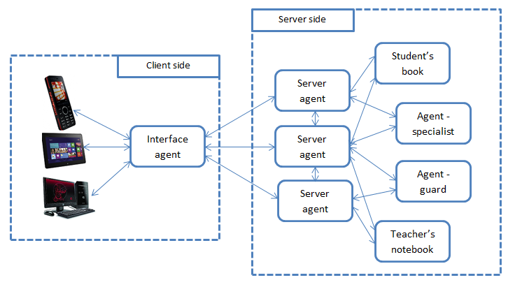
Pa architecture
Notes:
3 approaches are investigated:
Only front-end agent
Only back-end agent
Mixed

Slide 12
operatives
Operatives - specialized assistants usually located on the server nodes of the VES
Two groups:
DiLib operatives
Support the execution of the plans generated by the personal assistants
Implement suitable interfaces to the available electronic services and data repositories
Admin operatives
Planning, organization and documentation of the education
E.g. student’s book, teacher’s notebook, …

Slide 13
gards
Guards - special assistants which are responsible for safety and efficiently execution of the education scenarios in the space
Emergency scenarios
Usually intelligent devices that react to various physical quantities in the environment, e.g. smoke, temperature, humidity
Act as interfaces between the physical and the virtual world in the space

Slide 14
Space repositories
Two kinds of repositories:
Digital Libraries – repositories for electronic content
SCORM 2004 – eLectures
QTI 2.1 – eTesting
Administrative DBs – data for administration of the teaching
Lecture courses
Scenarios
Organizations
Sequensing & Navigation Rules
Aggregations
SCOs
Manifests
Assets

Slide 15
Implementation & modeling
Reengineering of the DeLC
Restructuring of the SCORM 2004 Engine
New version of the Test Engine
QTI 2.1. compliant
Agent-oriented
Event Engine (?)
Development of new components
Mobile personal assistants
Operatives
Repositories
Game-oriented learning
Modeling
CCA
jATempura
CS-Flow

Slide 16
Development tools
JADE
JADE-LEAP
Jadex Android

Slide 17
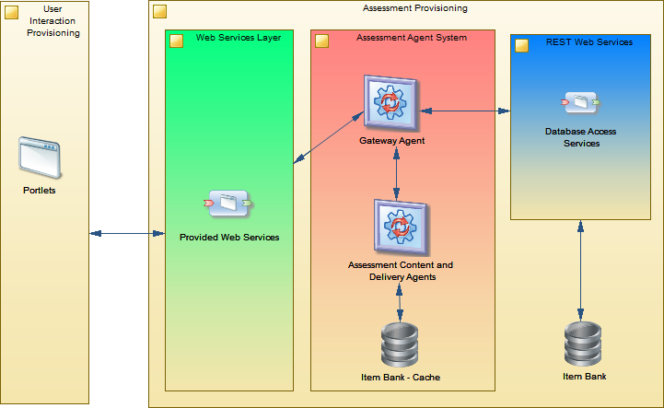
E-testing
Notes:
Нова версия, удовлетворяваща стандарта QTI 2.1.

Slide 18
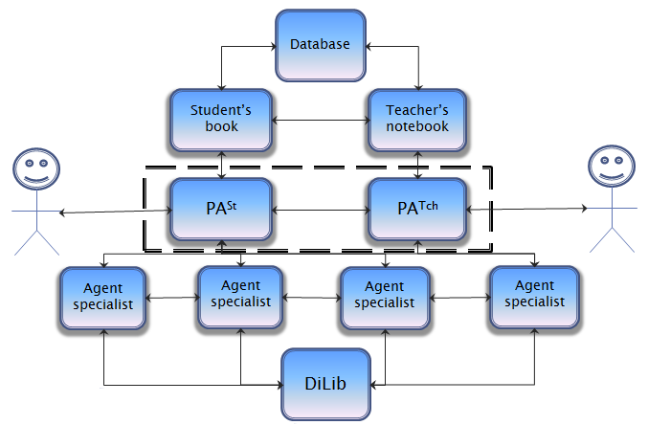
Dilib & admin subspaces

Slide 19
Game-oriented learning
Students
Teacher
GA
Game World
Meta World
PA^{T}
CA
Creativity Environment

Slide 20
Thank you!

